Slide 1

Narrative Techniques

Slide 2
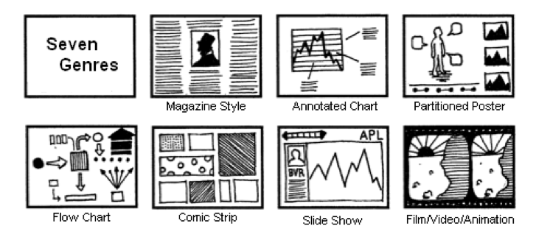
Segel and Heer, 2010

Slide 3
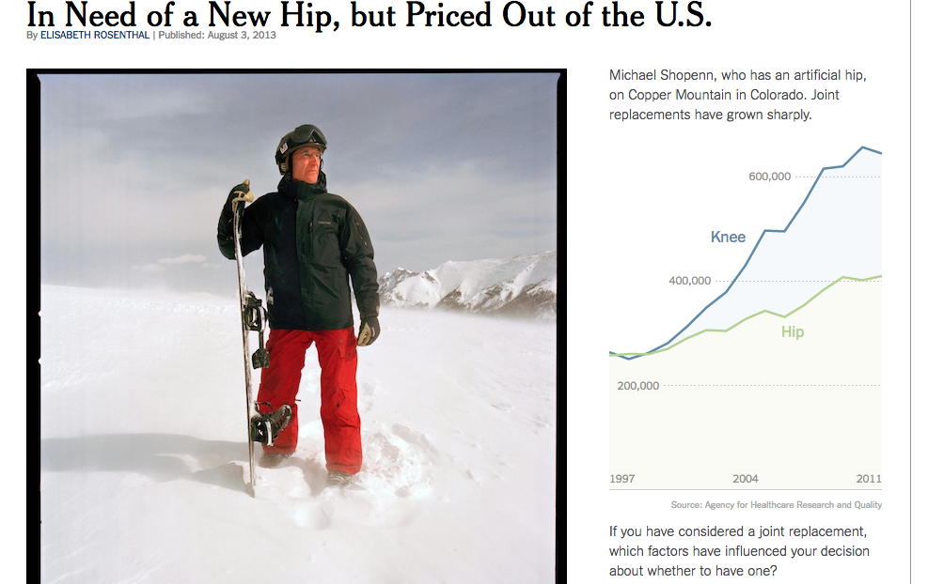
Magazine Style
http://www.nytimes.com/2013/08/04/health/for-medical-tourists-simple-math.html
Notes:
Image embedded in a page of text.

Slide 4
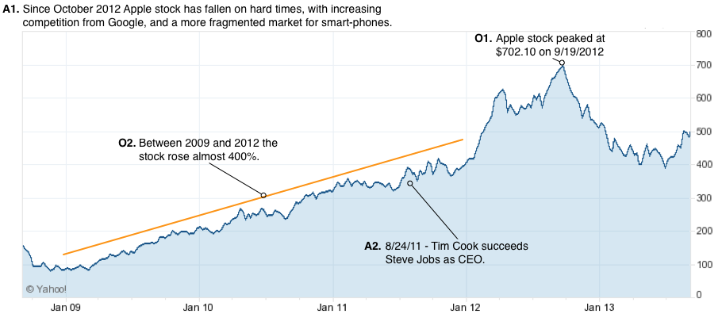
Annotated Chart
Notes:
http://towcenter.org/storytelling-with-data-visualization-context-is-king/

Slide 5
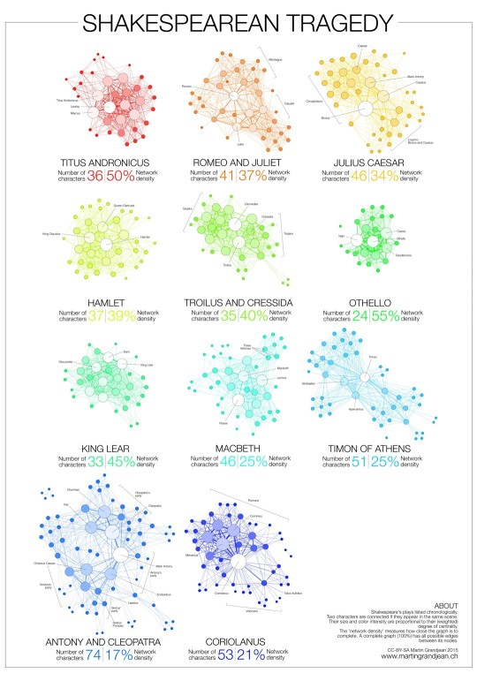
Partitioned Poster
Notes:
http://ebookfriendly.com/best-book-visualizations/

Slide 6
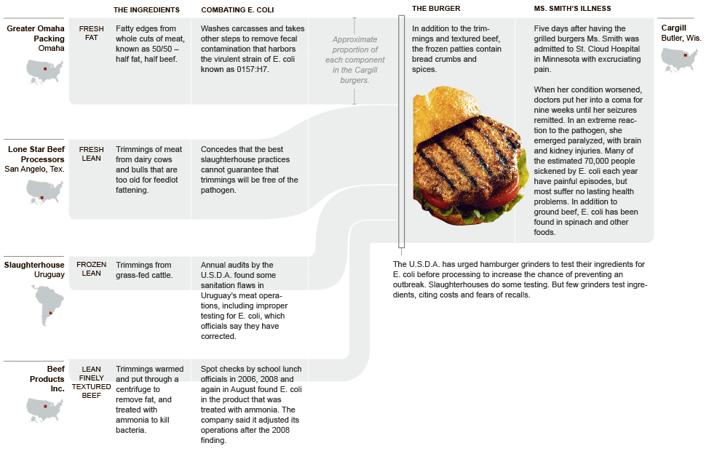
Flow Chart
https://static01.nyt.com/packages/flash/newsgraphics/2009/1004-meat/20091004-meat.gif

Slide 7
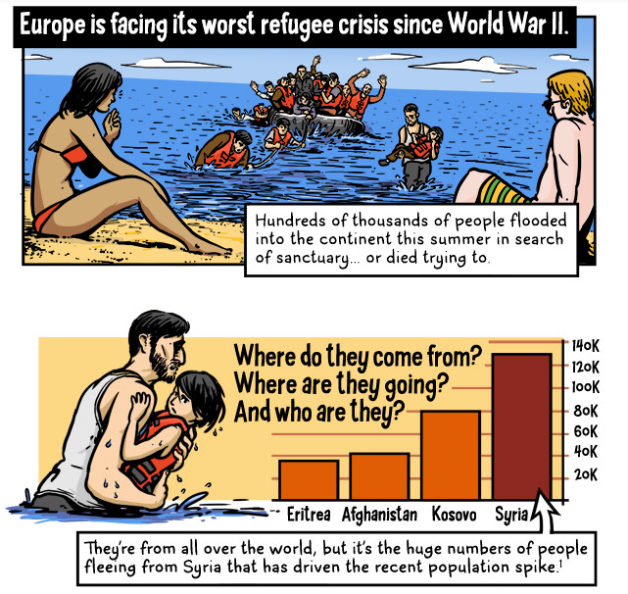
Comic Strip
https://ww2.kqed.org/lowdown/2015/09/28/searching-for-safety-europes-refugee-crisis-explained-comic-infographic/

Slide 8
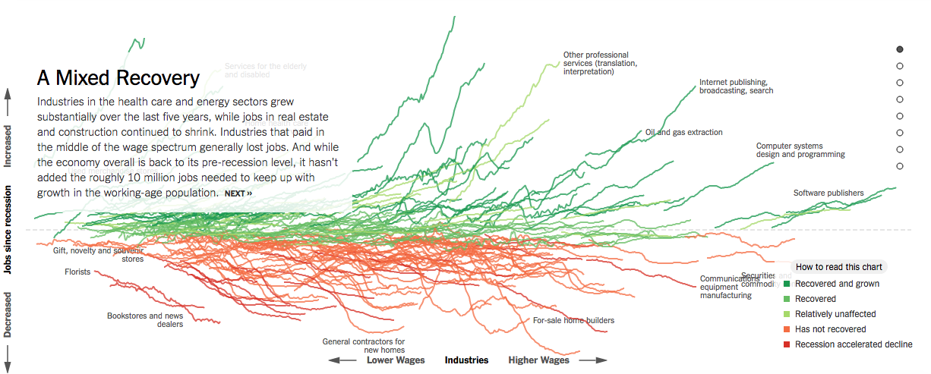
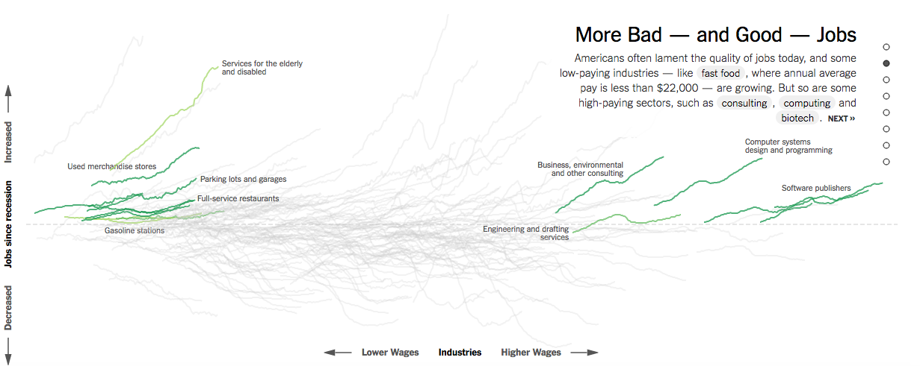
Slide Show
https://www.nytimes.com/interactive/2014/06/05/upshot/how-the-recession-reshaped-the-economy
-in-255-charts.html

Slide 9
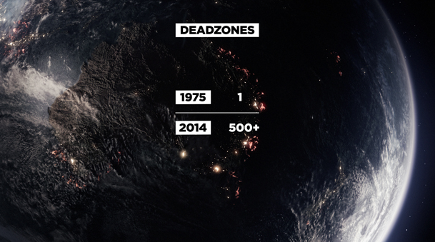
Film/ Video/ Animation
http://filmmakermagazine.com/87983-charting-the-course-data-visualization-in-documentary-film/

Slide 10
Slide show + annotated chart + ?
Notes:
Mix and match the genres as needed.

Slide 11
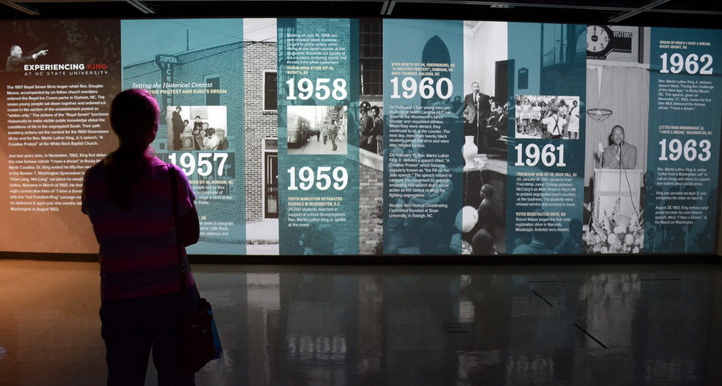
Visual structuring: communicates the structure of the narrative
Notes:
communicates the structure of the narrative and a viewer’s place within that structure

Slide 12
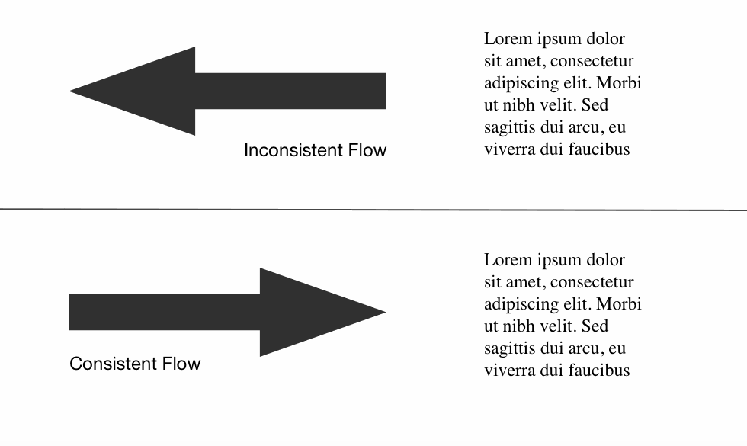
Flow: have the path the eye follows to align with the intended views/ interactions
Notes:
PLACEHOLDER IMAGE. https://www.smashingmagazine.com/2015/04/design-principles-compositional-flow-and-rhythm/
Draw on several commonly used graphic design principles compositional flow

Slide 13

Focal points & hierarchy: give the most important elements a ranking of perceptual focus
Notes:
PLACEHOLDER IMAGE. Draw on several commonly used graphic design principles
https://www.smashingmagazine.com/wp-content/uploads/2015/02/focal-points-large-preview-opt.png

Slide 14
[Placeholder example image of hierarchy for visual narrative]

Slide 15
Grids
Notes:
Alberto Cairo says to divide into rectangles of different sizes
He leaves out alignment, but it's there
Similar to idea of grids-based design

Slide 16
Highlighting: color, motion, framing, size, audio to direct attention to particular data
Data characters?
Notes:
Who are the data characters, organizations, events, people, patterns that are active in the story?

Slide 17
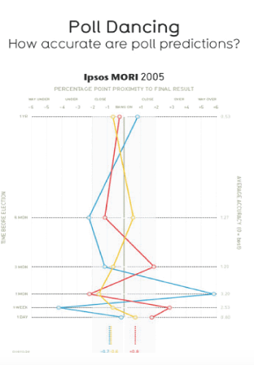
Visual Metaphor
Image Source: http://faculty.washington.edu/jhullman/vis_rhetoric.pdf

Slide 18
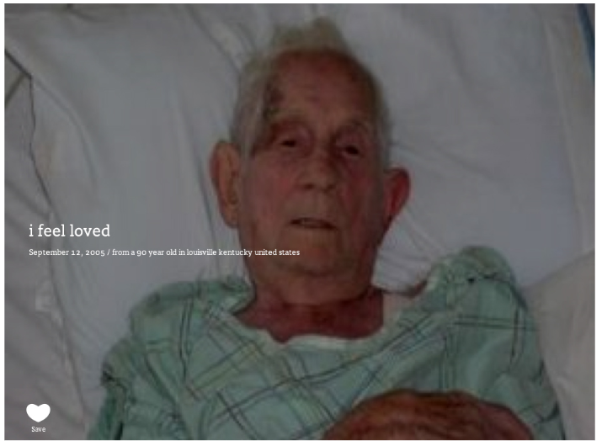
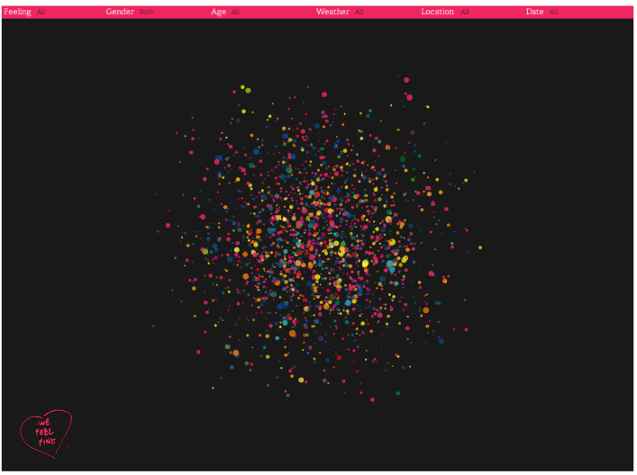
Give data a face &
context
WeFeelFine.org
Notes:
ca.edu/~rbegenhoefer/InfoViz/readings/wefeelfine.pdf

Slide 19
Transition guidance: help movement between scenes

Slide 20
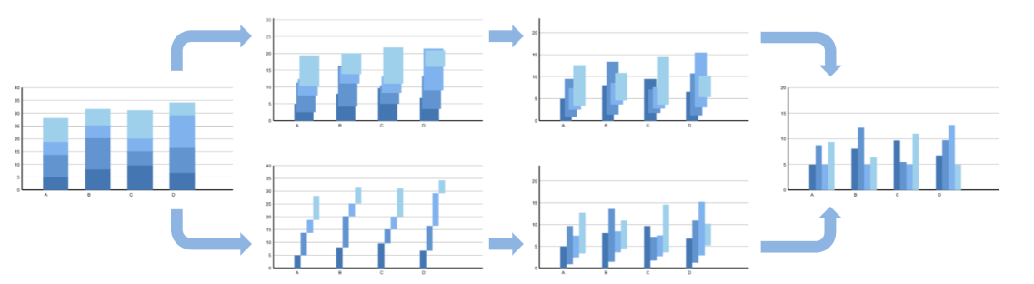
Animation
Timing + Staging
Diagram Source: Heer, J., & Robertson, G. (2007). Animated transitions in statistical data graphics. IEEE transactions on visualization and computer graphics, 13(6), 1240-1247.
Notes:
Breaking down staged transitions

Slide 21
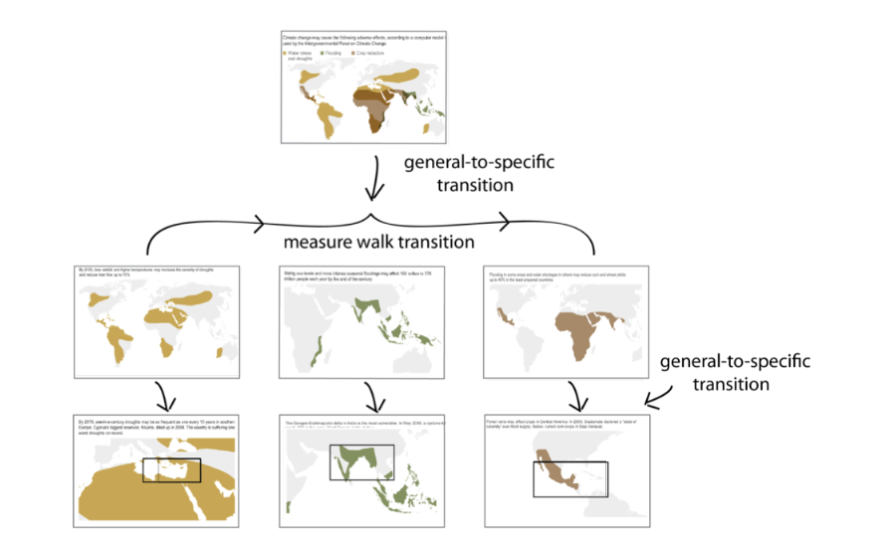
Transitions
Diagram Source: Hullman, J., Drucker, S., Riche, N. H., Lee, B., Fisher, D., & Adar, E. (2013). A deeper understanding of sequence in narrative visualization. IEEE Transactions on Visualization and Computer Graphics, 19(12), 2406-2415.
Notes:
https://www.microsoft.com/en-us/research/wp-content/uploads/2016/02/hullman.pdf

Slide 22
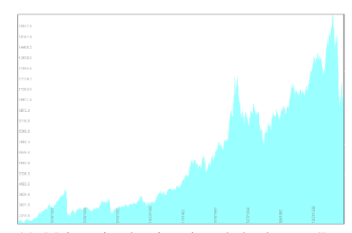
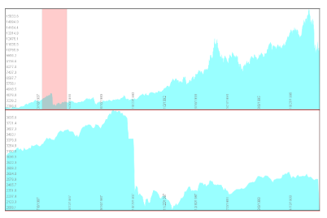
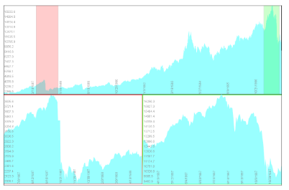
Stacked Zoom
Diagram Source: Javed, W., & Elmqvist, N. (2010, March). Stack zooming for multi-focus interaction in time-series data visualization. In Visualization Symposium (PacificVis), 2010 IEEE Pacific (pp. 33-40). IEEE.
Notes:
SHOULD BE MOVED TO INTERACTION WEEK!! http://citeseerx.ist.psu.edu/viewdoc/download?doi=10.1.1.443.1483&rep=rep1&type=pdf

Slide 23
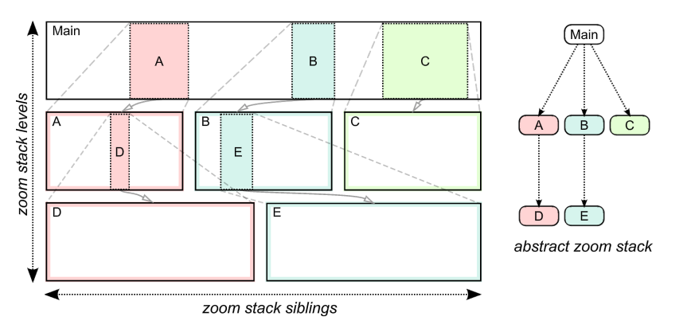
Stacked Zoom
Diagram Source: Javed, W., & Elmqvist, N. (2010, March). Stack zooming for multi-focus interaction in time-series data visualization. In Visualization Symposium (PacificVis), 2010 IEEE Pacific (pp. 33-40). IEEE.
Notes:
SHOULD BE MOVED TO INTERACTION WEEK!! http://citeseerx.ist.psu.edu/viewdoc/download?doi=10.1.1.443.1483&rep=rep1&type=pdf

Slide 24
Remember to use:
Ordering / Focus
Messaging
Interactivity
Notes:
Ordering both within the page and as the user moves through slides etc. What are the interactive features, what

Slide 25
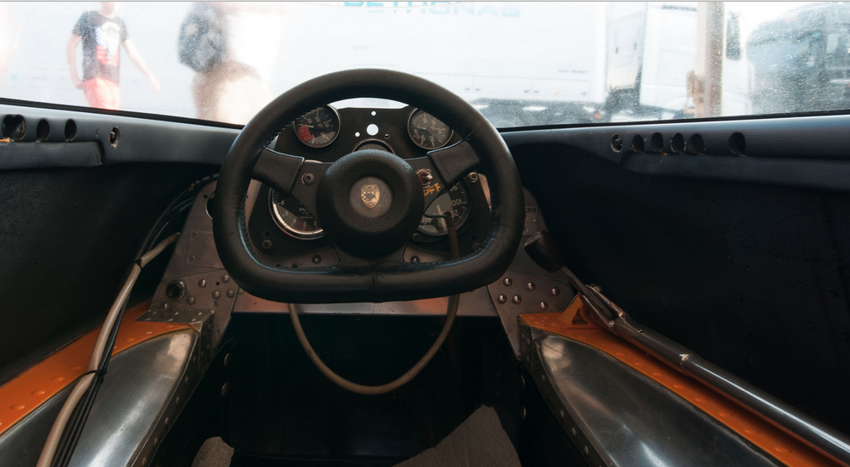
Who’s driving?
Notes:
https://www.flickr.com/photos/petercastleton/9296305418/

Slide 26
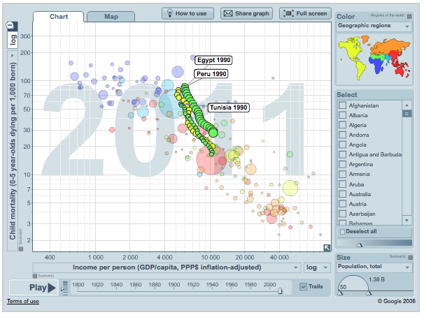
http://www.gapminder.org

Slide 27
Martini Glass Structure
author-driven reader-driven
[Placeholder for image]

Slide 28
Interactive Slide Show
author-driven reader-driven
[Placeholder for image]

Slide 29
Drill Down Story
author-driven reader-driven
[Placeholder for image]

Slide 30
Collaborative Narratives
[placeholder for image]
Notes:
With collaborative tagging etc.

Slide 31
Workflow
1. Settle on a story
2. Do research
3. Find visual analogies, make sketches
4. Flesh out the layout, graphic forms
5. Polish the details (words, icons)
Notes:
This is explanatory vis, you need to know the story.
Cairo: "define the focus"
Do research could be interviews, data gathering (start sketching)
Important to sketch early, play, iterate
Create layout from sketches
Polish the details only at the end

Slide 32
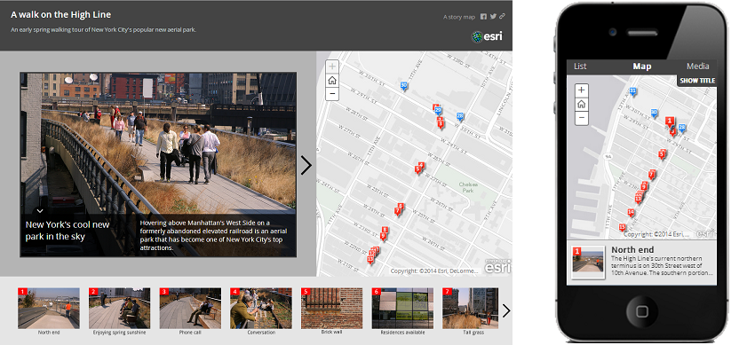
Template vs. Custom?
https://github.com/Esri/map-tour-storytelling-template-js
Notes:
Don’t just take the template path of least resistance.

Slide 33
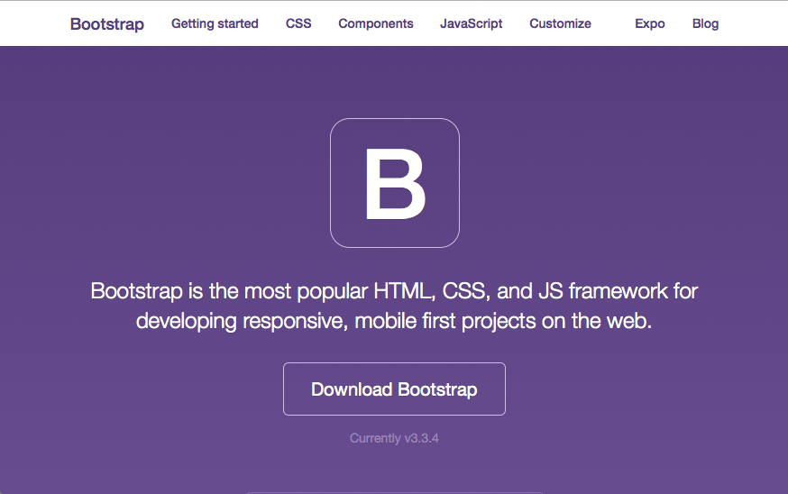
Getbootstrap.com
Notes:
Bootstrap – most popular responsive web dev library
Define columns, fixed or responsive

Slide 34
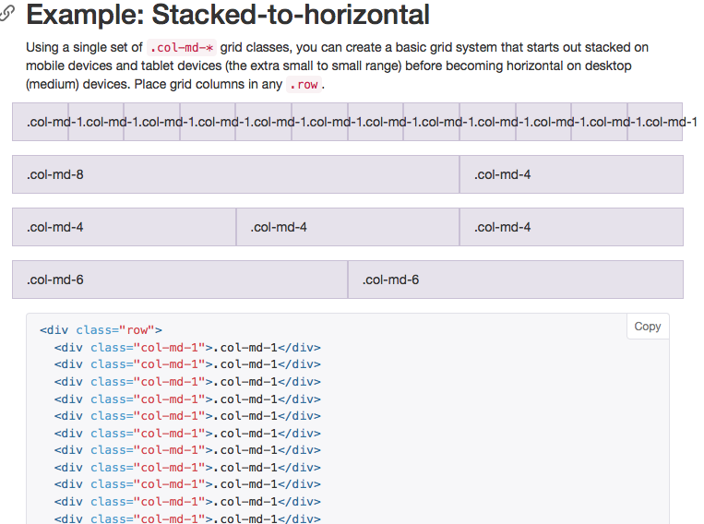
Notes:
Bootstrap – most popular responsive web dev library
Define columns, fixed or responsive

Slide 35
Story Evaluation
Interviews (5 + / – participants)
Surveys on affect/ emotion
Engagement across pages/ content
Analysis of annotations or comments
Crowdsourcing data collection
Notes:
How do you evaluate an effective story? The evaluation methods so far have largely focused on task not enjoyment. Might decide to re-order content or vis slides to go from a drill down to a build up. Other outcomes – does it drive responses, uptick in calls, etc.

Slide 36
Tools
Tableau Stories
Story Maps
https://storymaps.arcgis.com/en/
Notes:
Add as web link

Slide 37


